Slide 1
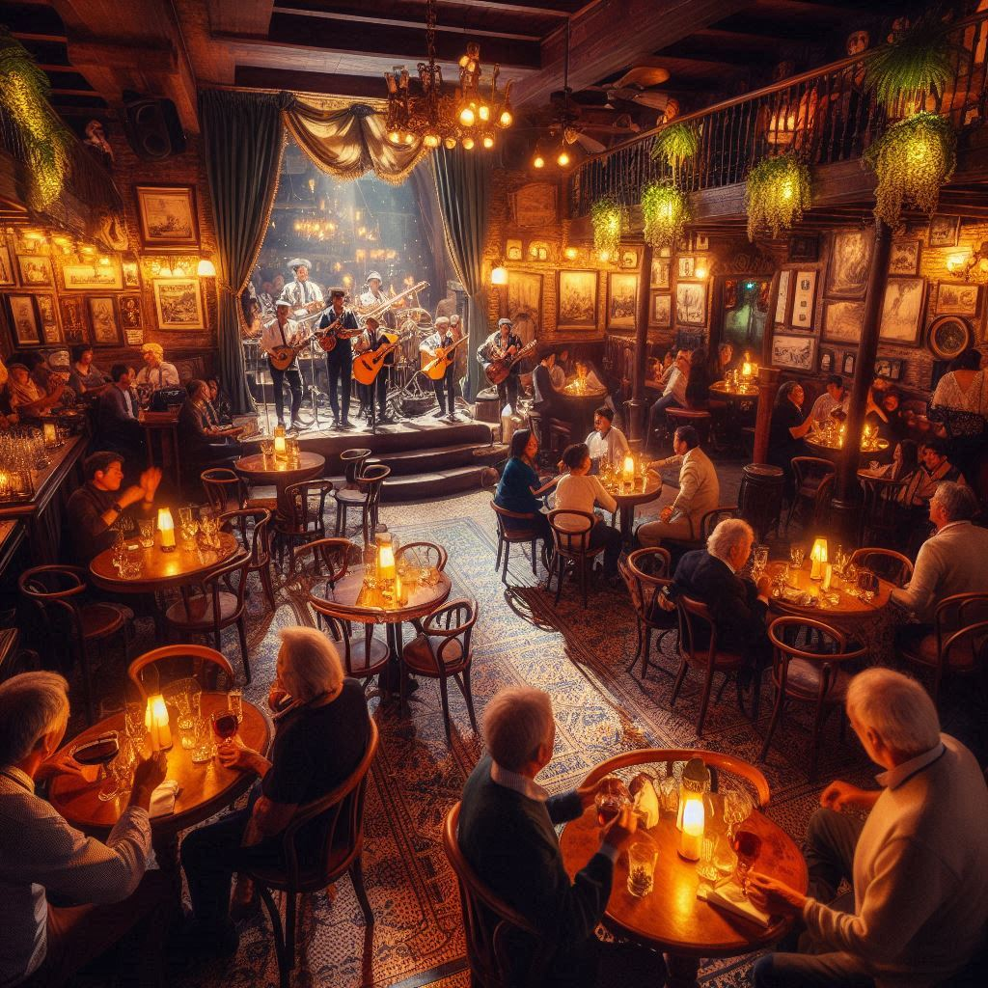
Bar Coradonno
Enter speak easy meet Agustas Larkin, Luis DeMendoza, and Jessie Hughs (Jackson Elias)
Discuss why we are here
Larkin smells and coughs
Larkin and DeMendoza leave
Elias give his real name – books he’s written/ why he’s here
Researching Death cults the pyramid of legends and the monsters that keep people a way the karisiri

Slide 2
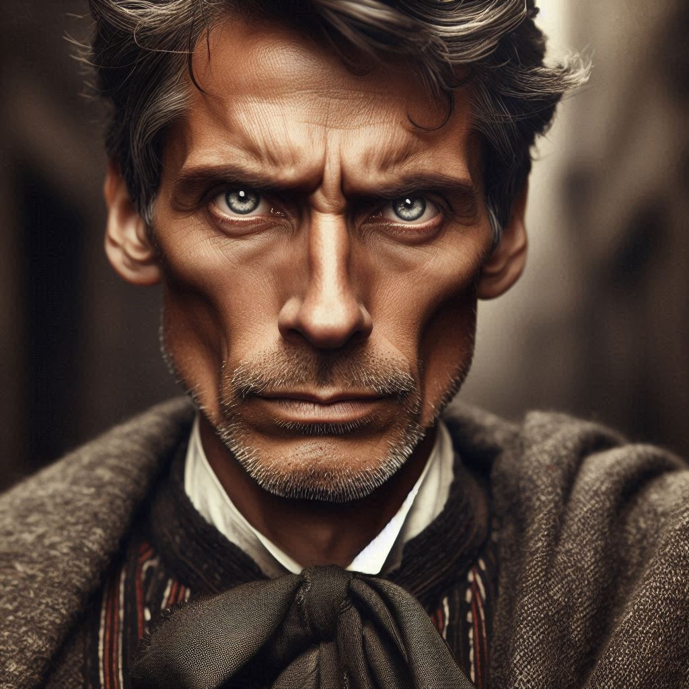
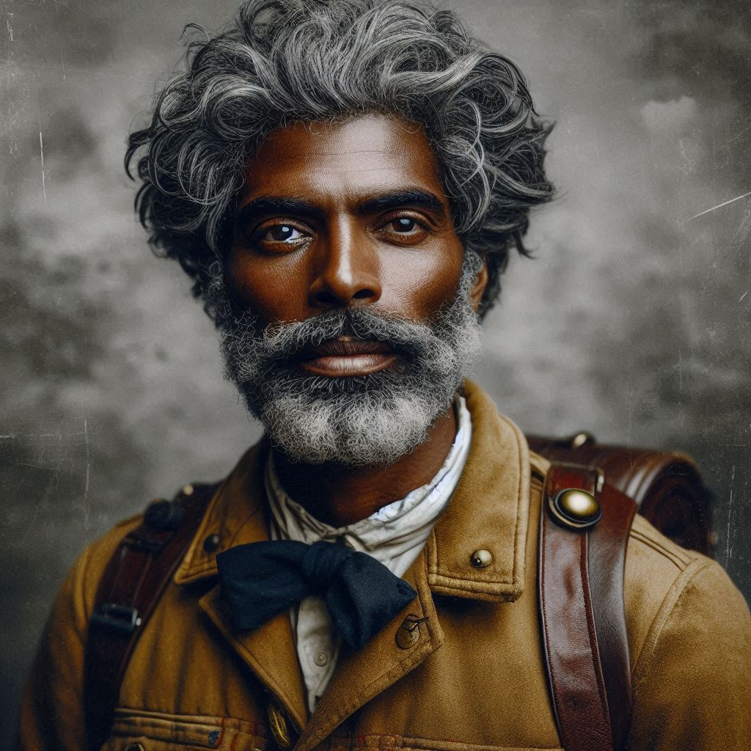
Elias mentions his friend Professor Nemesio Sanches
Luis DeMendoza looks angry and starts but rarely speaks following him will lead to his hotel room mask is under the bed

Slide 3
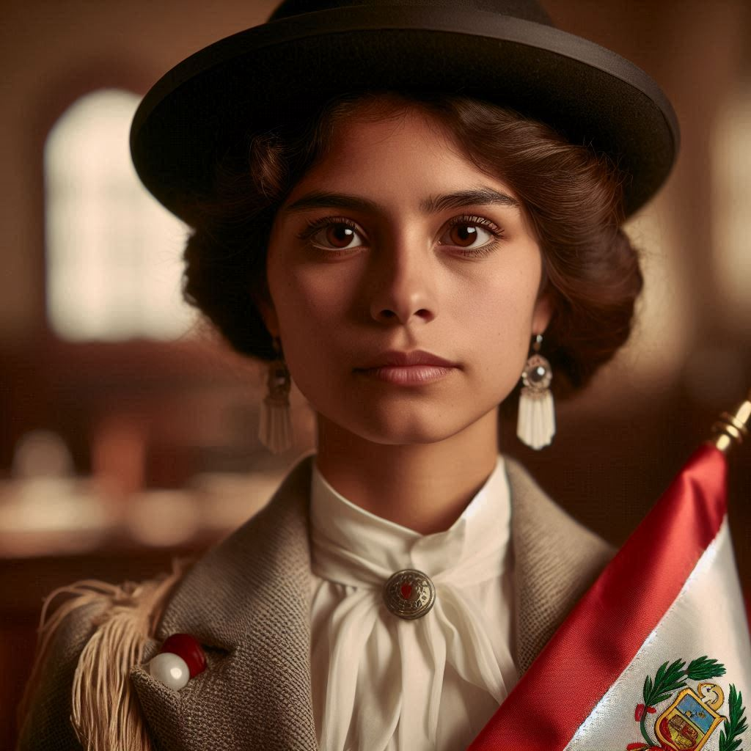
If they go research -Trinidad Rizo
Should eventually be found dead in the basement
Gold ornate thing with her. No fat left in body with a round hole in her chest.
Orate thing has burnt flesh on it

Slide 4
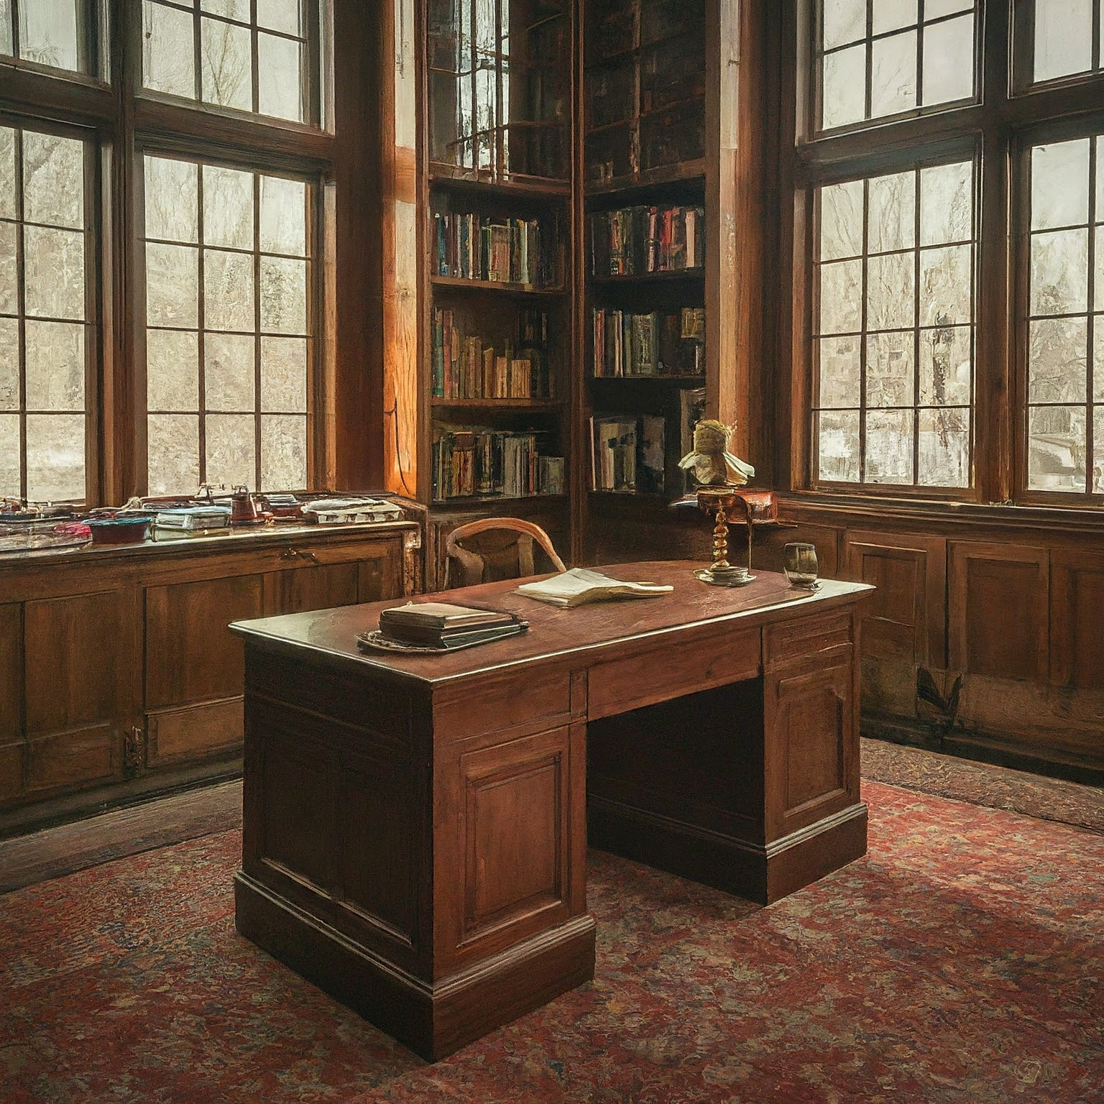
Professor Nemesio Sánchez
Prof Sanchez tells us the pyramid is real
If we gain his trust. Tells us about Karisiri who came from conquistadors
Nemesio tells us the beasts came from spain and are all white men with blue eyes just legend though meet my student.
Come back tomorrow for some reason.

Slide 5
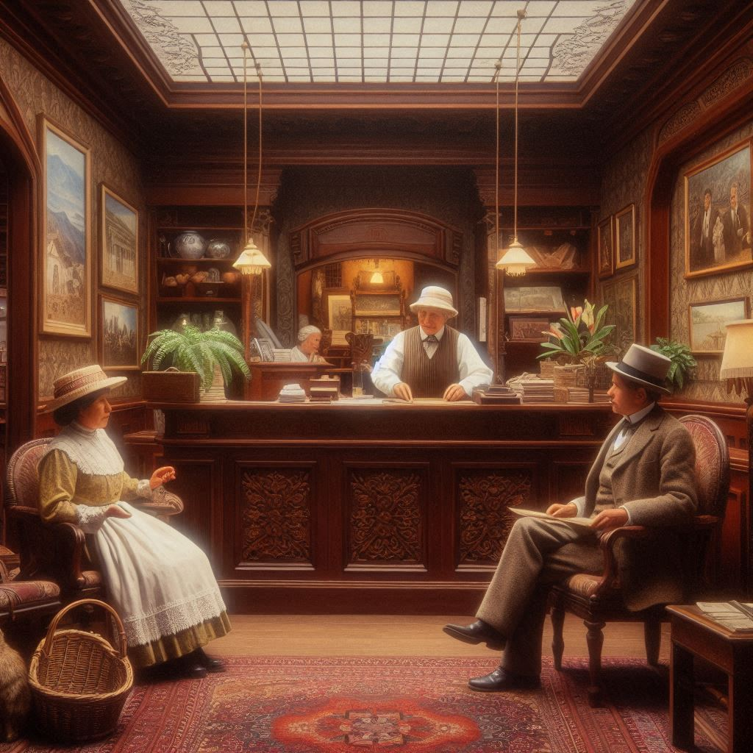
Petronila Cupitina Hotel owner wont let in without a roll

Slide 6
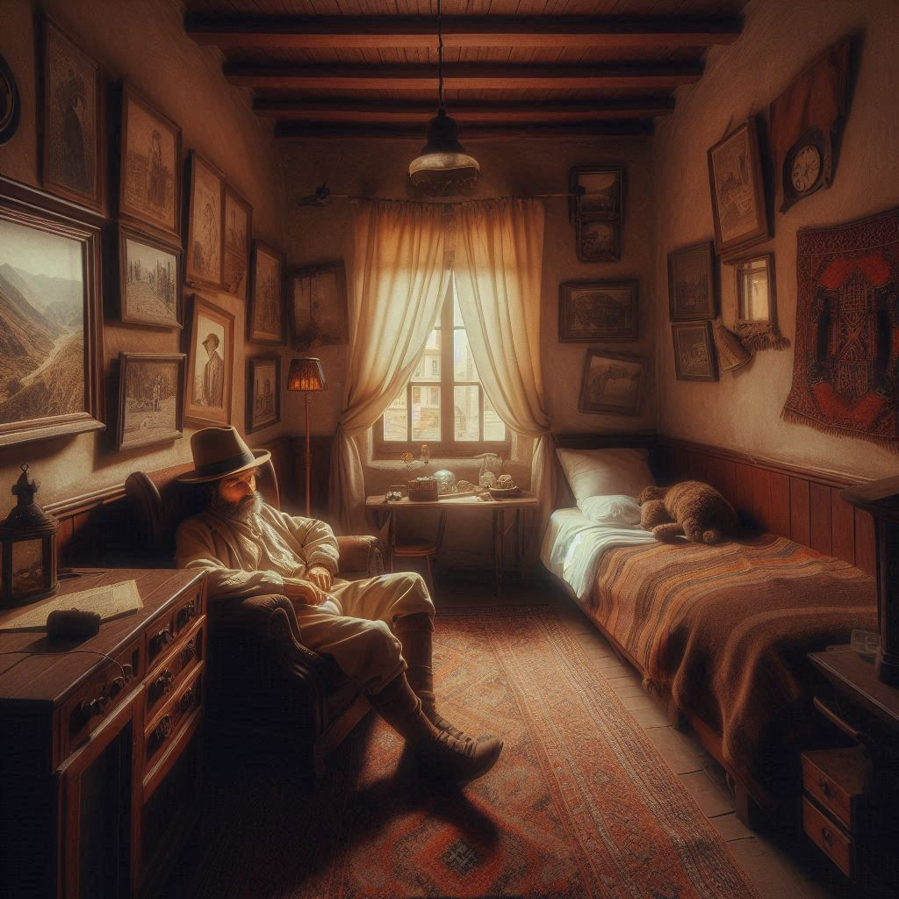
Larkin is asleep looking close shows he is passed out
Spot hidden shows his drug use
Great success shows his tattoo

Slide 7
DeMendoza’s room is locked
Mask found near his bed

Slide 8
Professor Nemesio Sánchez
Elias tells us to return to Sanchez. Begin talking hear a terrible sound from the basement storage.
We find the gold etching a broken open crate, Trinidad is dead gaunt and has a gaping hole in her chest. The etched gold has burnt flesh on it. We head back up stairs to find a trash fire. Stopping there gives karisiri time to escape. Nemesio has acid on mouth and a buldge in his stomach.

Slide 9
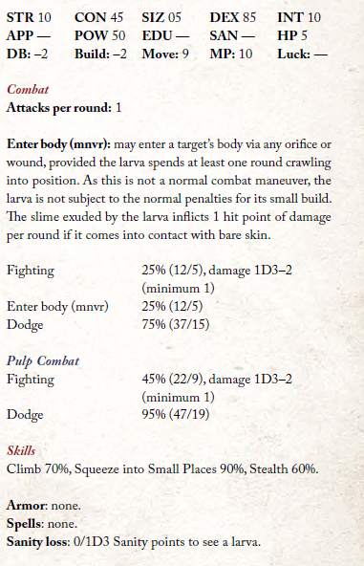
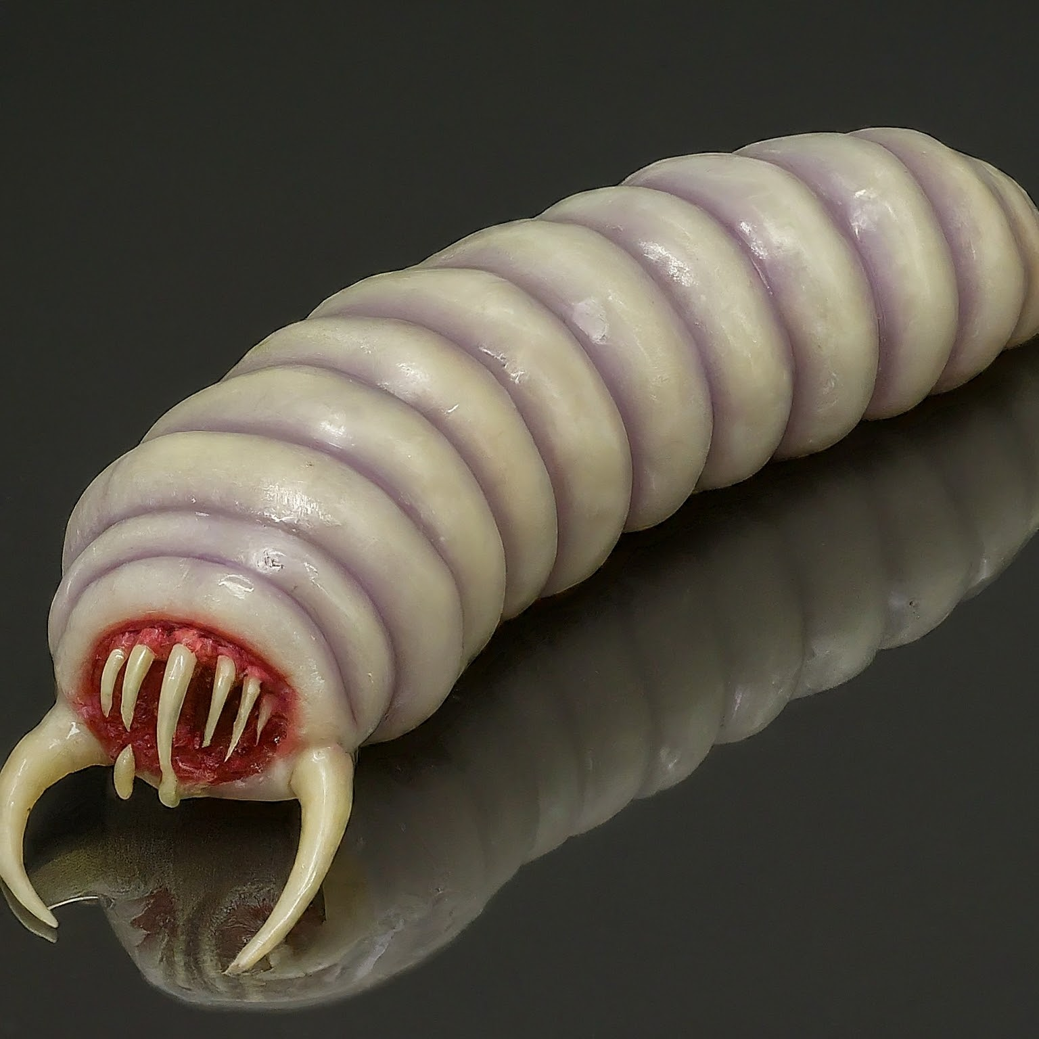

Slide 10
Heading to the island
Roll fortune for any goods we wish to purchase.
DeMendoza has told us he is not coming. Needs to tend to some family things.

Slide 11
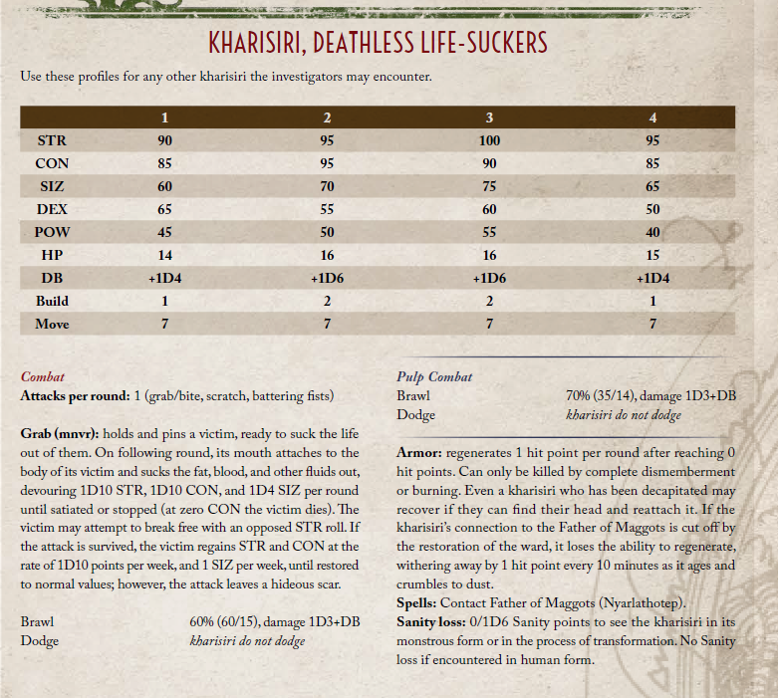
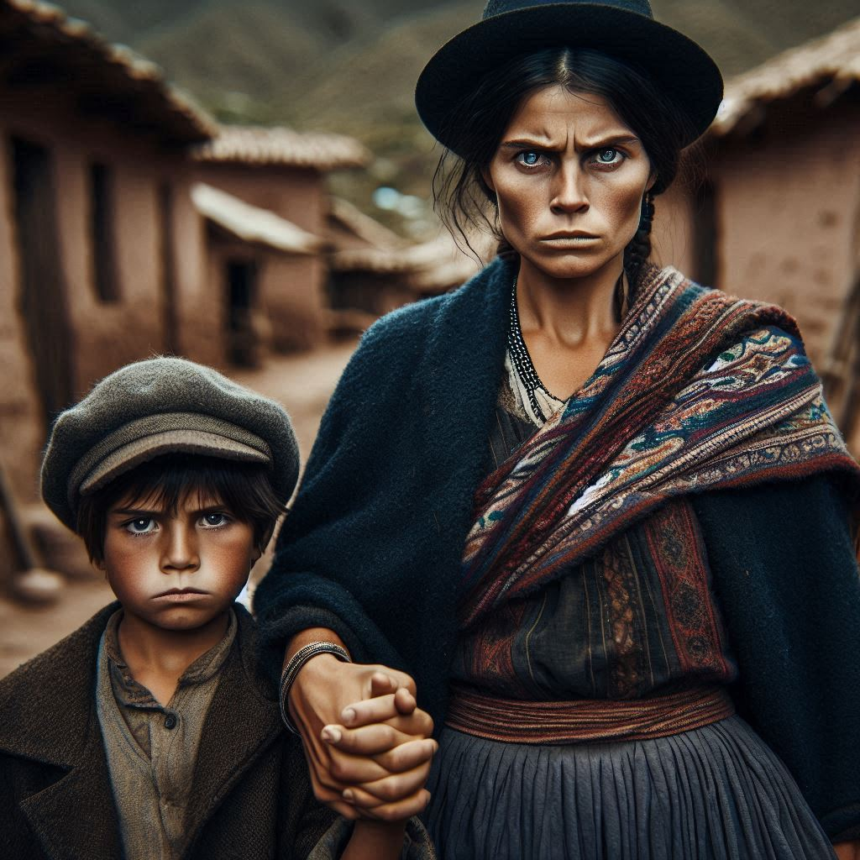
Isla Blanca

Slide 12
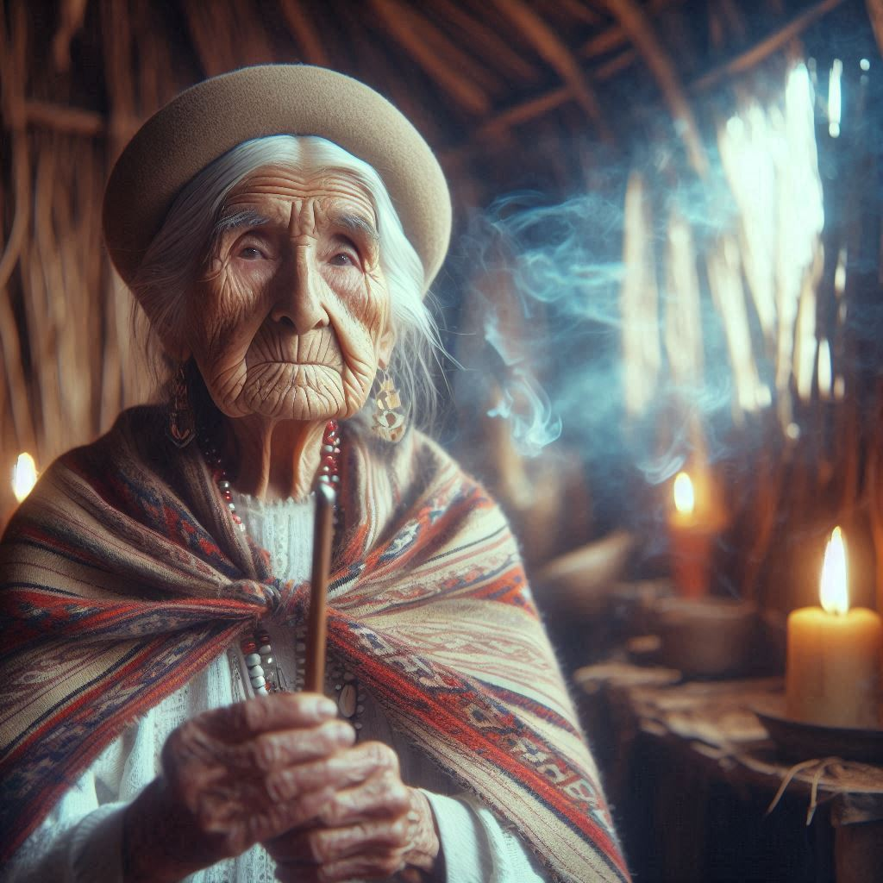
Nayra the clairvoyant
Tells us the story of a conquistador that crossed the land sewing destruction his name was Luis DeMendoza

Slide 13
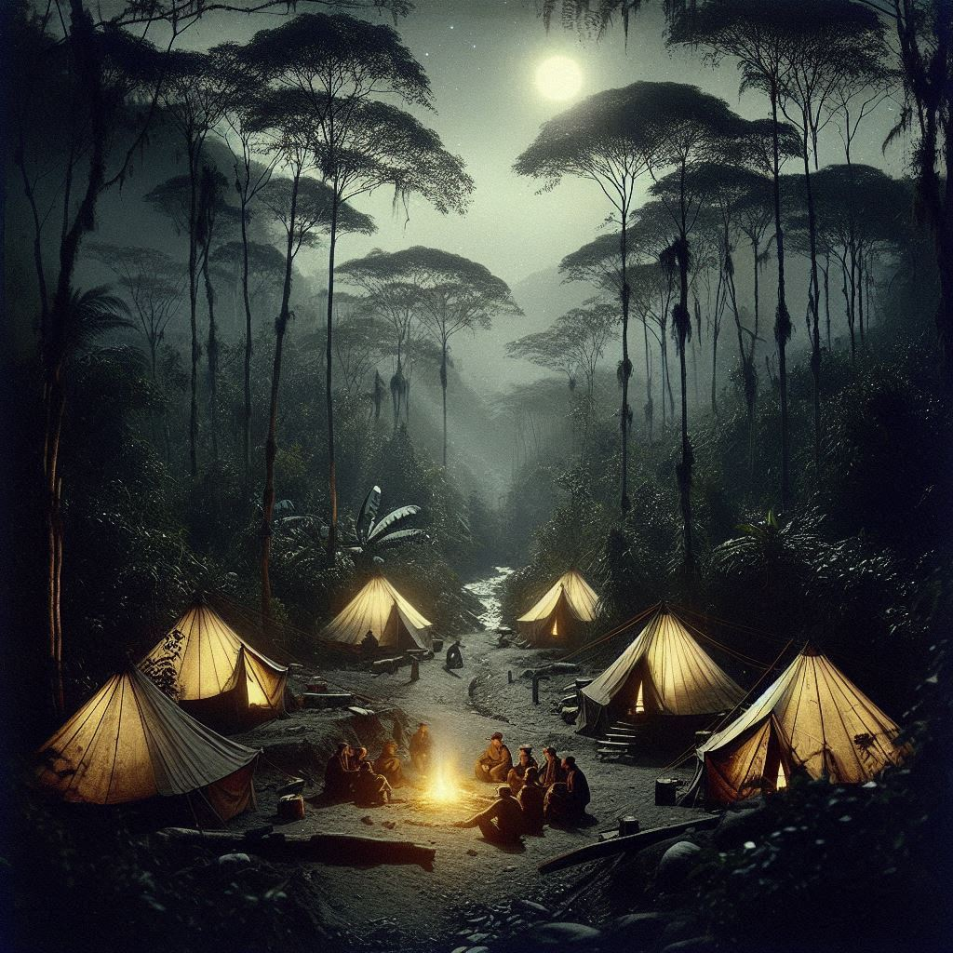
Camp site first night on the island
Roll const for altitude sickness
If we don’t keep watch the donkeys die
Karisiri will run if spotted

Slide 14
Overlook – spotting the Karisiri
Fat with distended bellies we spot them from the overlook heading towards the pyramid

Slide 15
Meeting Julio Cespedes and Domingo his son
Son is wounded and suspicious gaping hole in his chest – he knows where the pyramid is if Larkin is gone or dead.
Saving the son will result in him handing over weapons or some medicine or anything needed. Will need a great success on medicine

Slide 16
The climb
Climb up here Larkin will either attempt to convince them to go in the front door or will turn on them depending how sus they are.
If he turns the karisiri are waiting when we enter if not we see them vomit and he leads us in. The doors will close and DeMendoza is there with two karisiri and two maggots.

Slide 17
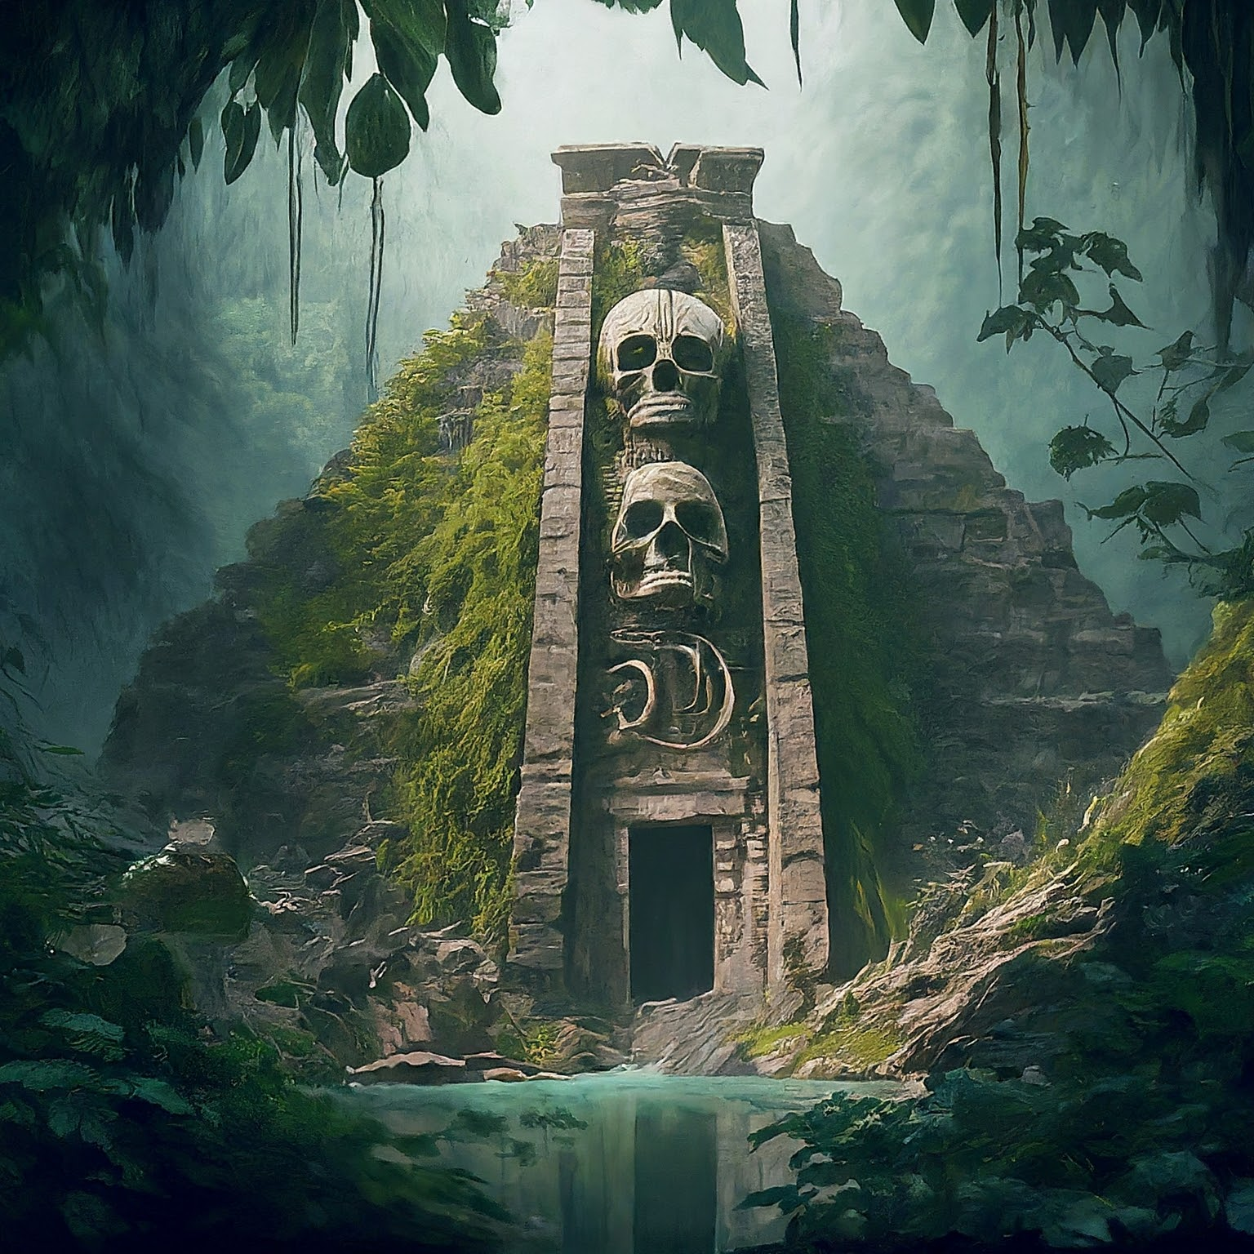
Tracking the Karisiri leads to Pyramid

Slide 18
Pyramid entry has front door and bone shoot
sálvame padre de los gusanos
sálvame padre de los gusanos
Karisiri enter front door and vomit into a crack – many more karisiri this way including Mendoza. Here they turn on you
Bone shoot leads to room with rags that turn into mummmies
Past there brings us down to the lake which has some missing gold work across the lake. Replacing this will halt the dripping and burning the lake will kill the father of maggots.
If Larkin is alive he will try to stop you or feed you to karisiri.
DeMendoza dies and turns to dust – salvame padre de los gusanos

